Slide 1
IPL AUCTION
MOTIVE

Slide 2
List of 10 batsman with high batting strike rate who have faced atleast 500 balls
batsman | batsman_sr
AD Russell | 182.3
SP Narine | 164.3
HH Pandya | 159.3
V Sehwag | 155.4
GJ Maxwell | 154.7
RR Pant | 152
AB de Villiers | 151.9
CH Gayle | 150.1
KA Pollard | 149.9
JC Buttler | 149.6
SELECT batsman,ROUND((SUM(batsman_runs)*1.0/COUNT(ball))* 100,2) as batsman_sr
from IPL_ball WHERE
extras_type not in ('wides')
GROUP BY batsman
HAVING
COUNT (ball)>500
ORDER BY
batsman_sr DESC
LIMIT10;

Slide 3
List of 10 players with best average who have
played more than 2 IPL seasons (or 28 matches)
BATSMAN | RUNS | AVERAGE
KL Rahul | 2647 | 42.69
AB de villiers | 4849 | 42.54
DA Warner | 5254 | 41.7
JP Duminy | 2029 | 41.41
CH Gayle | 4772 | 41.14
ML hayden | 1107 | 41
LMP Simmons | 1079 | 39.96
KS Williamson | 1619 | 39.49
SE Marsh | 2477 | 38.7
ML Hussey | 1977 | 38.02
SELECT batsman,
SUM(batsman_runs)AS runs,
ROUND(SUM(batsman_runs)*1.0/SUM(is_wicket),2)AS
average
FROM IPL_ball GROUP BY
batsman
HAVING
SUM(is_wicket)> 0 AND COUNT (DISTINCT id)>28
ORDER BY
average DESC
LIMIT 10;

Slide 4
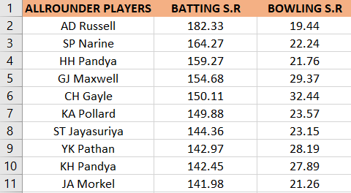
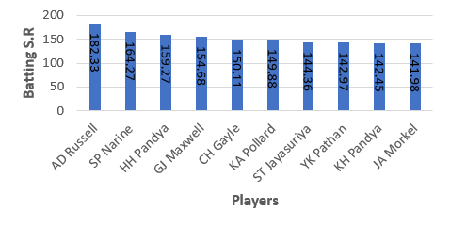
List of 10 allrounders who have the best bowling and batting strike rate and who gave faced at least 500 balls and bowled at least 300 balls.
SELECT
a.batsman AS all_rounder,
a.batsman_sr,
b.bowling_sr
FROM batting_sr a
INNER JOIN
bowling_sr b ON a.batsman = b.bowler
ORDER BY
a.batsman_sr DESC,
b.bowling_sr ASC
LIMIT 10;

Slide 5
List of 10 players who have scored most runs in
boundaries and have played more than 2 IPL seasons
(more than 28 matches
batsman | boundary_percentage
SP Narine | 81.17
AD Russell | 78.71
CH Gayle | 76.07
ST Jayasuriya | 74.22
AC Gilchrist | 72.89
V Sehwag | 72.29
DR Smith | 70.52
CA Lynn | 69.53
Harbhajan Singh | 68.52
SR Watson | 68.25
SELECT batsman,
ROUND(SUM(CASE WHEN batsman_runs in(4,6)
THEN batsman_runs else 0 END)* 1.0/
SUM(batsman_runs)* 100,2)AS
boundary_percentage
from IPL_ball
WHERE
extras_type NOT IN ('wides')
GROUP BY
batsman
HAVING
COUNT(DISTINCT ID)>28
ORDER BY
boundary_percentage DESC
LIMIT 10;

Slide 6
WITH ValidDismissals AS (
SELECT
bowler,
is_wecket,
CASE
WHEN dismissal_kind IN ('bowled', 'caught', 'caught and bowled', 'hit wecket', 'lbw', 'stumped')
THEN 1
ELSE 0
END AS is_valid_dismissal
FROM ipl_ball
)
SELECT
bowler,
ROUND(COUNT(bowler) * 1.0 / SUM(is_valid_dismissal),2) AS economy
FROM
ValidDismissals
GROUP BY
bowler
HAVING
COUNT(bowler) > 500
ORDER BY
economy
LIMIT 10;
bowler | economy
K Rabada | 13.77
AJ Tye | 16.13
DE Bollinger | 16.22
Imran Tahir | 16.43
SL Malinga | 17.49
S Aravind | 17.51
MA Starc | 18
YS Chahal | 18.08
KK Cooper | 18.18
TA Boult | 18.29

Slide 7
List of 10 bowlers with best economy who have bowled at least 500 balls in IPL
bowler | economy
Rashid Khan | 6.33
A Kumble | 6.65
M Muralitharan | 6.68
DW Steyn | 6.77
R Ashwin | 6.77
SP Narine | 6.82
DL Vettori | 6.83
Washington Sundar | 6.89
J Botha | 6.92
R Tewatia | 6.99
SELECT
bowler,
ROUND(SUM(total_runs)/(COUNT(bowler)/6.0), 2)
as economy
FROM ipl_ball
GROUP BY
bowler
HAVING
COUNT(bowler) > 500
ORDER BY
economy
LIMIT 10;

Slide 8
Additional Questions

Slide 9
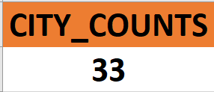
1. Get the count of cities that have hosted an IPL match.
SELECT COUNT(DISTINCT City) AS Total_Cities_Hosted_IPL_Match
FROM IPL_Matches;

Slide 10

3. Write a query to fetch the total number of boundaries and dot balls from the deliveries_v02 table.
SELECT
COUNT(CASE WHEN ball_result = 'boundary' THEN 1 END) AS total_boundaries,
COUNT(CASE WHEN ball_result = 'dot' THEN 1 END) AS total_dot_balls
FROM deliveries_v02;

Slide 11
dismissal_kind | total_dismissals
bowled | 1700
caught | 5743
caught and bowled | 269
hit wicket | 12
lbw | 571
obstructing the field | 2
retired hurt | 11
run out | 893
stumped | 294
2. Create table deliveries_v02 with all the columns of the table ‘deliveries’ and an additional column ball_result containing values boundary, dot or other depending on the total_run (boundary for >= 4, dot for 0 and other for any other number)
CREATE TABLE deliveries_v02 AS
SELECT *,
CASE
WHEN total_runs >= 4 THEN 'boundary’
WHEN total_runs = 0 THEN 'dot’
ELSE 'other’
END AS ball_result
FROM ipl_ball;

Slide 12
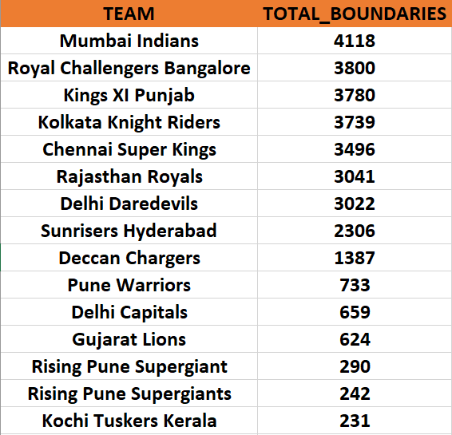
4. Write a query to fetch the total number of boundaries scored by each team from the deliveries_v02 table and order it in descending order of the number of boundaries scored.
SELECT batting_team,
COUNT( case WHEN ball_result = 'boundary' THEN 1 END) AS total_boundaries
FROM deliveries_v02
GROUP BY batting_team
ORDER BY total_boundaries DESC;

Slide 13
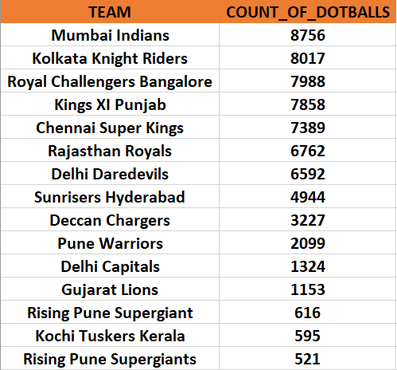
5. Write a query to fetch the total number of dot balls bowled by each team and order it in descending order of the total number of dot balls bowled
SELECT bowling_team,
COUNT(CASE WHEN ball_result = 'dot' THEN 1 END) AS total_dot_balls
FROM deliveries_v02
GROUP BY bowling_team
ORDER BY total_dot_balls DESC;

Slide 14

6. Write a query to fetch the total number of dismissals by dismissal kinds where dismissal kind is not NA.
dismissal_kind | total_dismissals
bowled | 1700
caught | 5743
caught and bowled | 269
hit wicket | 12
lbw | 571
obstructing the field | 2
retired hurt | 11
run out | 893
stumped | 294
SELECT dismissal_kind, COUNT(*) AS total_dismissals
FROM deliveries_v02
WHERE dismissal_kind != 'NA'
GROUP BY dismissal_kind;

Slide 15
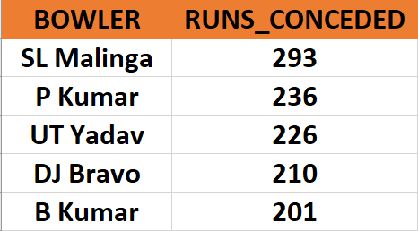
7. Write a query to get the top 5 bowlers who conceded maximum extra runs from the deliveries table.
SELECT bowler, SUM(CAST(extra_runs AS INT)) AS total_extra_runs
FROM deliveries_v02
GROUP BY bowler
ORDER BY total_extra_runs DESC
LIMIT 5;

Slide 16
8. Write a query to create a table named deliveries_v03 with all the columns of deliveries_v02 table and two additional column (named venue and match_date) of venue and date from table matches.
CREATE TABLE deliveries_v03 AS
SELECT
d.*,
m.venue,
EXTRACT(DAY FROM m.date) AS date
FROM deliveries_v02 d
LEFT JOIN
ipl_match m ON d.id = m.id;

Slide 17
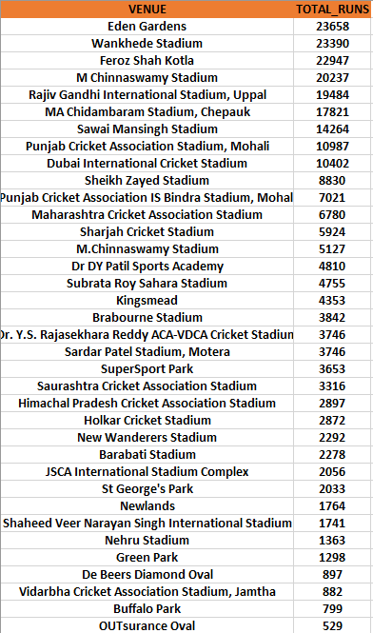
9. Write a query to fetch the total runs scored for each venue and order it in the descending order of total runs scored.

Slide 18
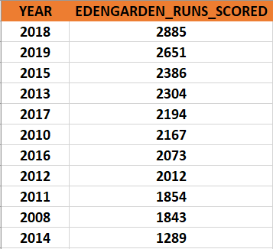
10. Write a query to fetch the year-wise total runs scored at Eden Gardens and order it in the descending order of total runs scored.

